Slide 1

Car Evaluation Using Machine Learning
A Comparative Analysis of Classification and Clustering Approaches
Name: Bovas Benson
Course: MGT-665-NW – Solving Problems with Machine Learning
Date: July 8th, 2025

Slide 2
Abstract
This study applies machine learning to assess car acceptability based on categorical attributes like safety, price, and capacity.
It compares supervised models (like SVM, Random Forest) with unsupervised clustering (K-Means, DBSCAN).
Results showed that SVM had the highest accuracy (96.8%), while clustering methods revealed less distinct patterns.
Dimensionality reduction with PCA was used to visualize class distribution.

Slide 3
Introduction
Traditional car evaluations rely on human judgment—prone to bias and inconsistency.
ML allows automated, data-driven evaluation.
Goal: Predict how acceptable a car is based on attributes such as purchase price, safety level, number of doors, etc.
This benefits consumers, manufacturers, and regulators.

Slide 4
Related Work
Many studies have used decision trees on the classic UCI car dataset.
Some reached 90%+ accuracy using classification.
Few have used PCA or clustering to explore patterns without labels.
This study fills that gap by comparing supervised and unsupervised approaches.

Slide 5

Dataset Summary
1
2
Dataset from Kaggle
Features Included
1,728 entries, 7 categorical features.
buying, maintenance, doors, persons, lug_boot, safety, and target class.
3
4
No Missing Values
One-Hot Encoding
Clean for analysis.
Used to convert categories into numbers.

Slide 6
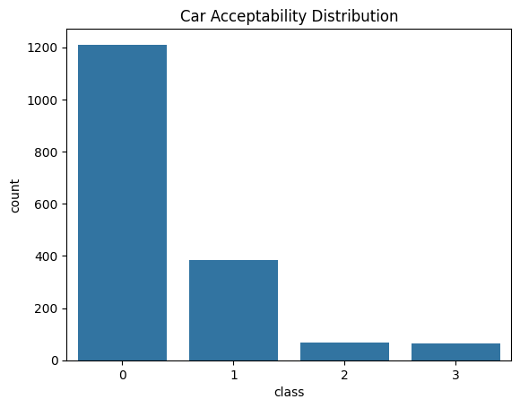
EDA – Class Imbalance
“Unacceptable” cars dominate the dataset.
This imbalance may cause models to favor the majority class.
Important to address during training to ensure fairness.

Slide 7
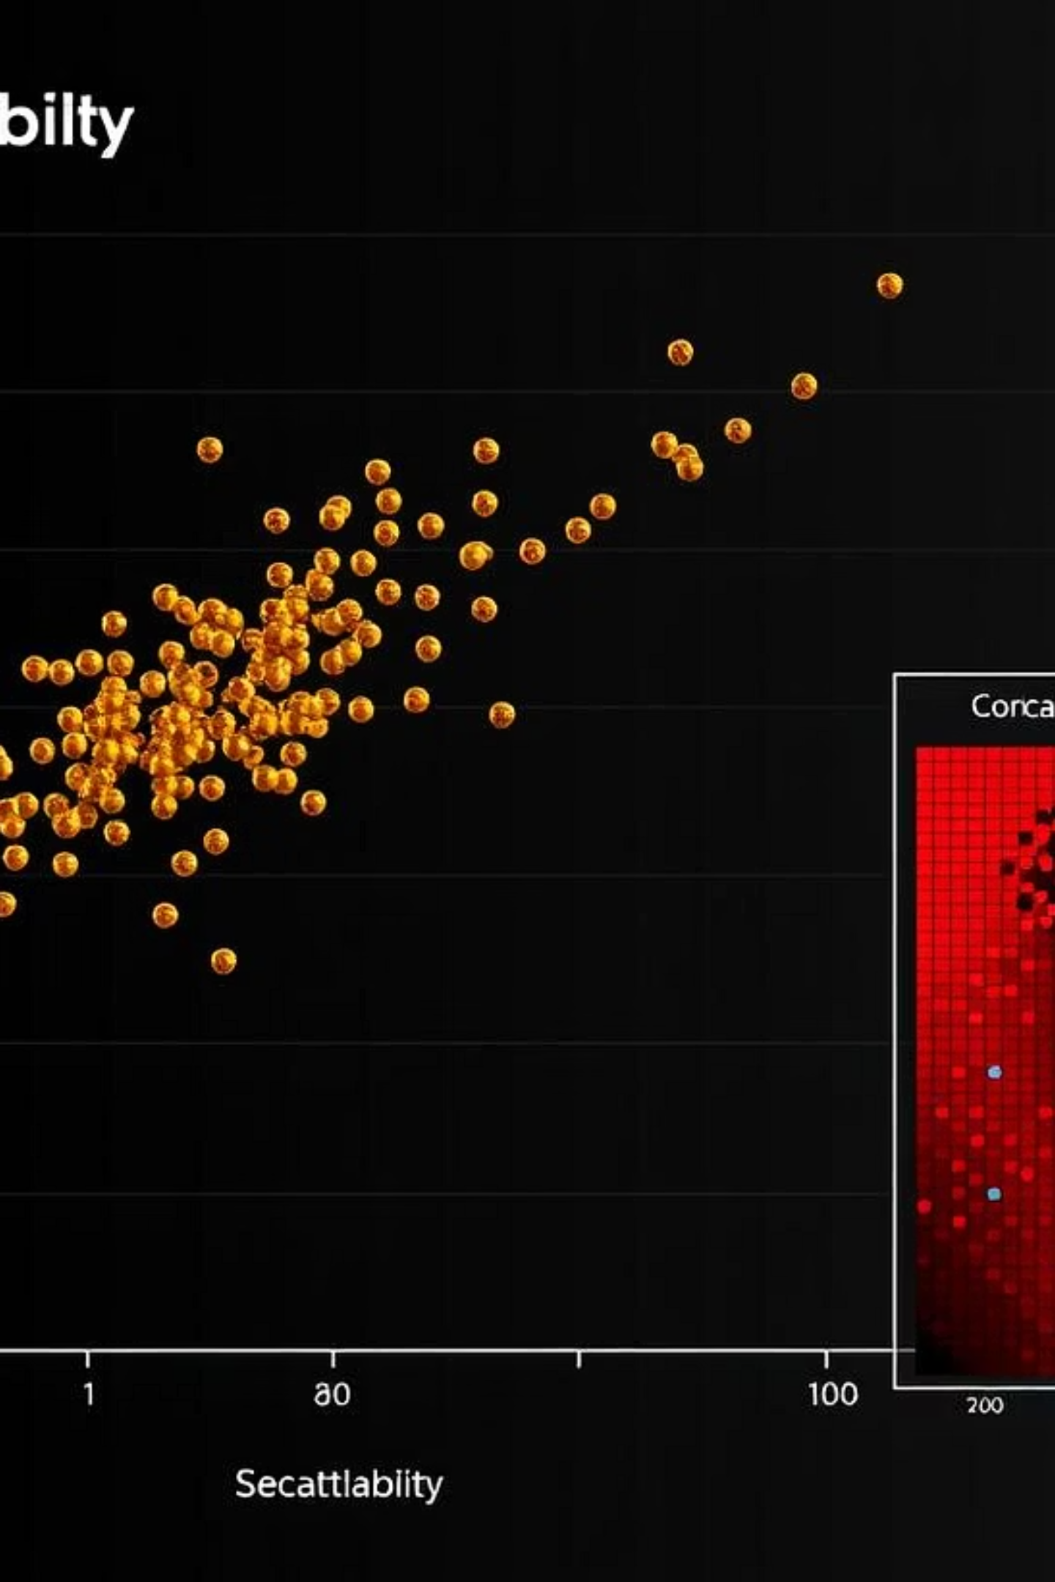
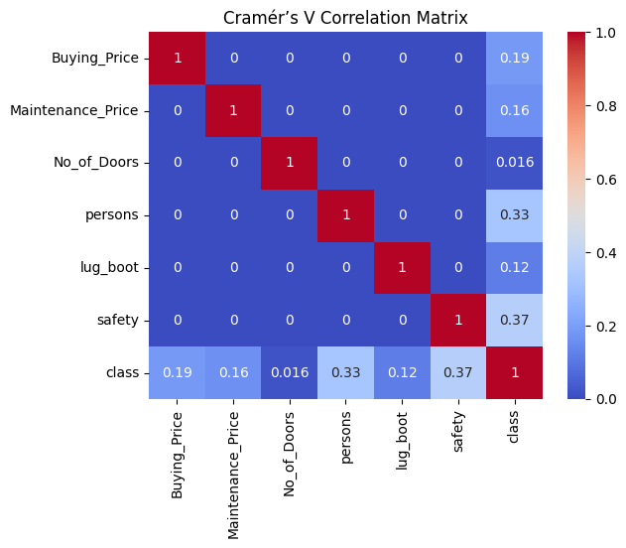
EDA – Feature Trends
Cars with high safety and low price have better acceptability.
Visualizations showed clear trends in how features affect car classification.
A Cramér’s V heatmap showed strong correlation between buying, safety, and class.

Slide 8
Classification Models
Five models used for prediction:
Evaluation used: Accuracy, Precision, Recall, and F1 Score.
Logistic Regression
Data split: 80% training, 20% testing.
k-Nearest Neighbors (k-NN)
Decision Tree
Random Forest
Support Vector Machine (SVM)

Slide 9
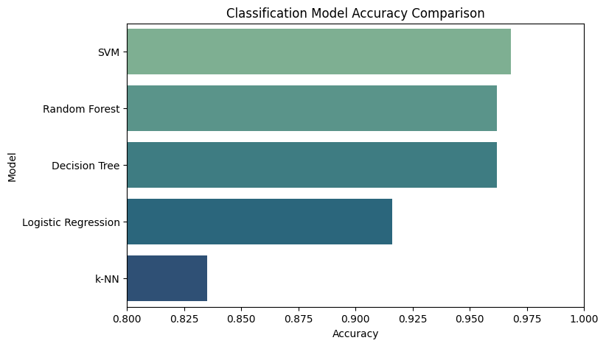
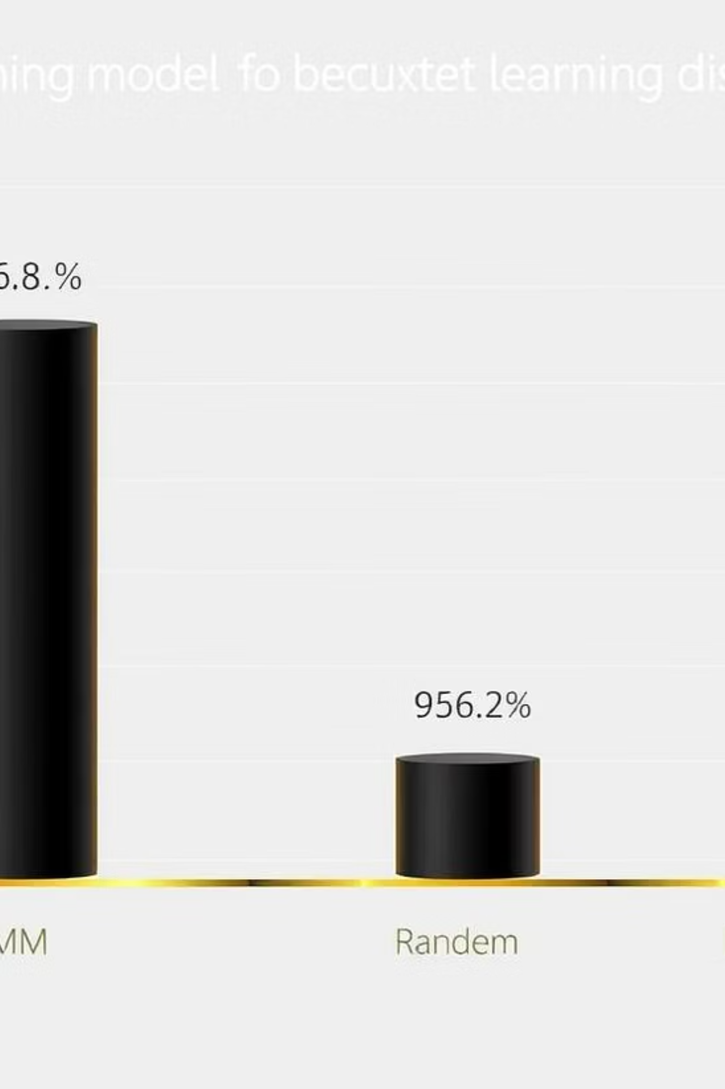
Classification Results (Best Models)
SVM had the highest accuracy: 96.8%—great at distinguishing all classes.
Random Forest and Decision Tree close behind: ~96.2%.
These models handle categorical splits and interactions well.

Slide 10
Classification Results (Other Models)
Logistic Regression
k-NN
Model Struggles
91.6%, good for general trends but weaker with rare classes.
83.5%, low accuracy due to issues with one-hot encoded, high-dimensional data.
Models struggled more with predicting less common classes.

Slide 11
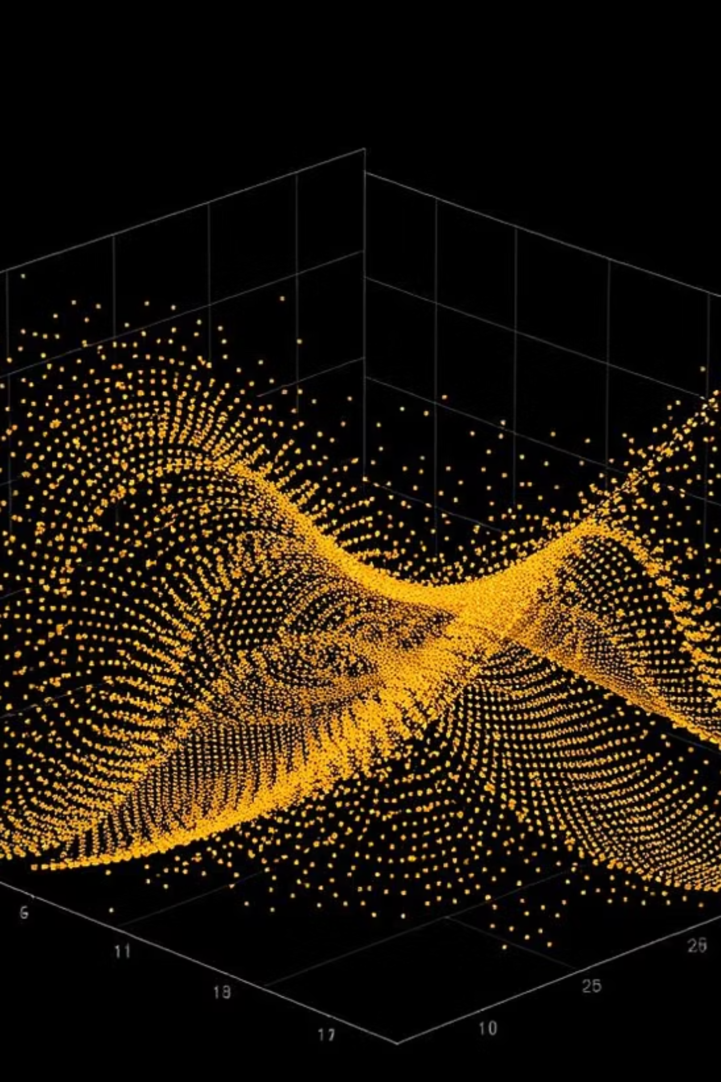
PCA – Dimensionality Reduction
PCA compressed high-dimensional features into 2 principal components.
Helped visualize natural separation between classes.
Some classes like “unacc” and “acc” were visibly clustered, others overlapped.

Slide 12
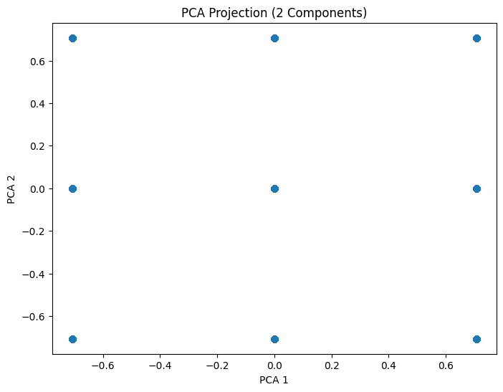

Slide 13

PCA – Explained Variance
90%
8%
2%
First Component
Second Component
Remaining Components
Captures the majority of the dataset's variation.
Adds further significant variation explanation.
Account for the minor, residual variation.
First few components captured most of the dataset’s variation.
PCA is useful for visual insight and reducing model complexity, not for clustering itself.

Slide 14
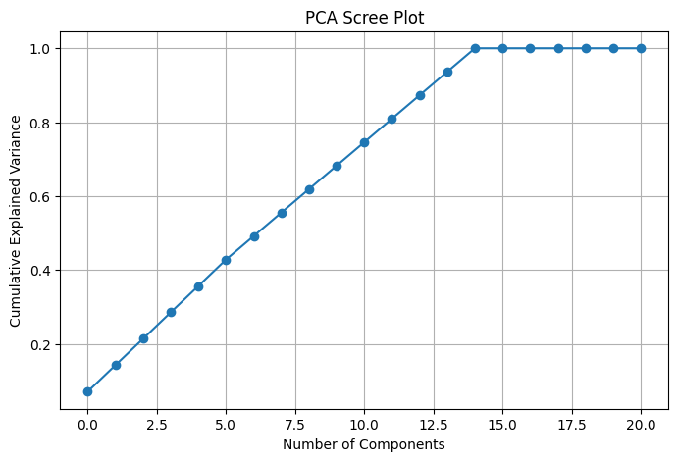

Slide 15
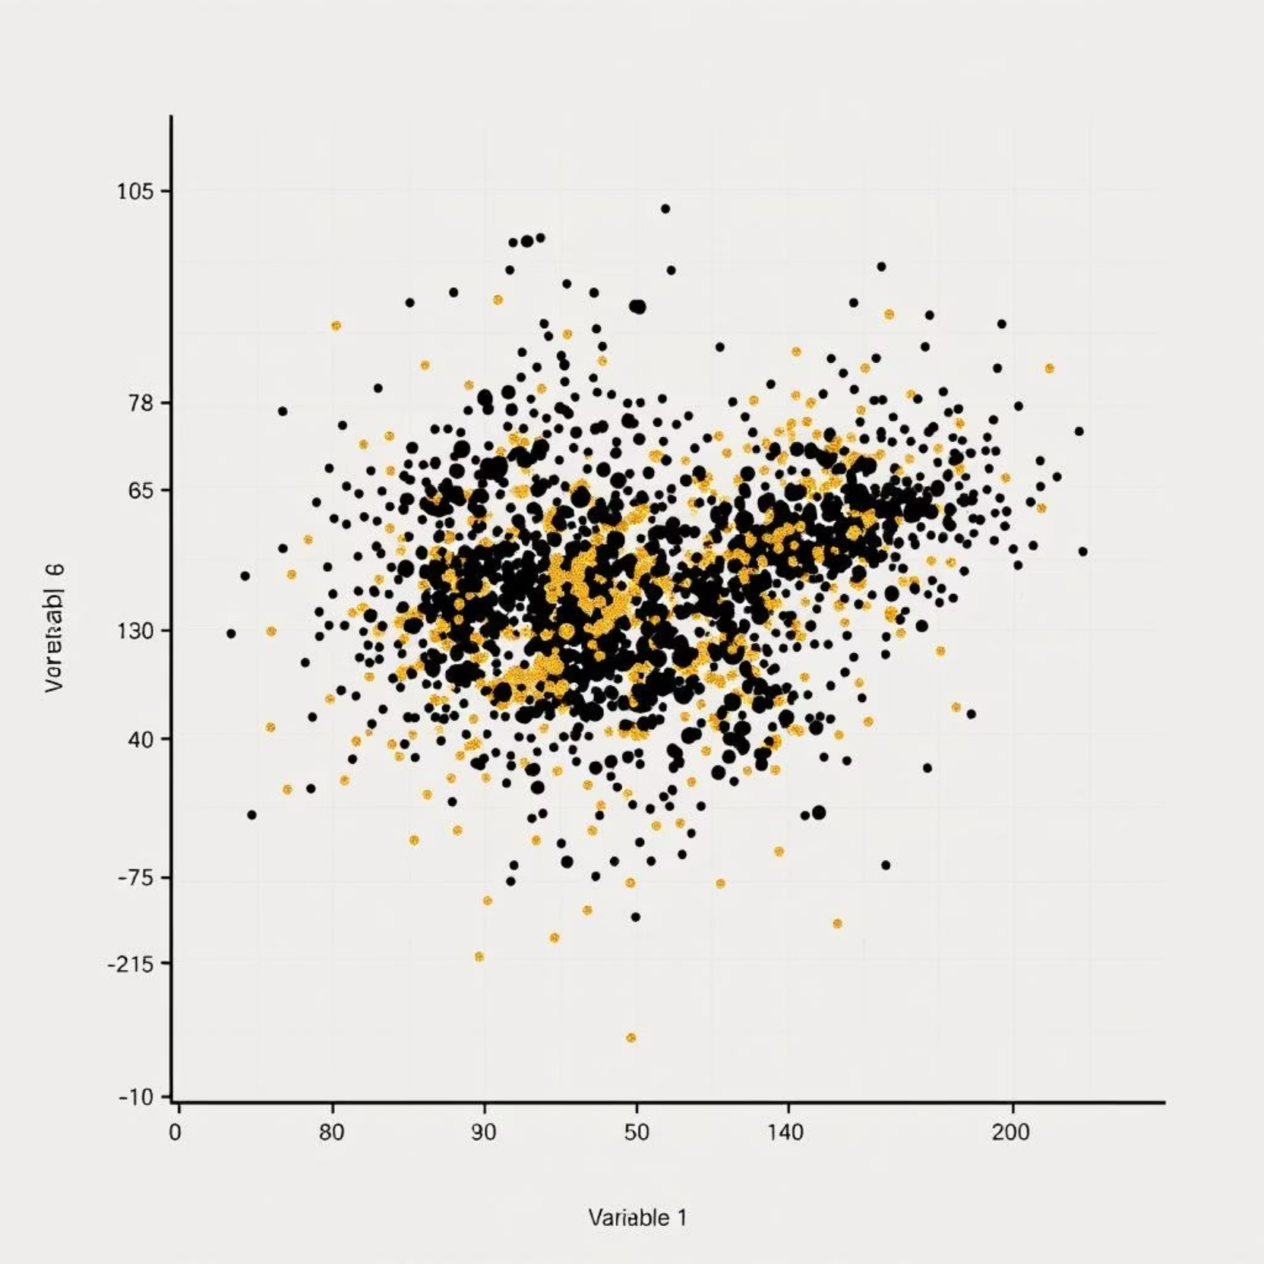
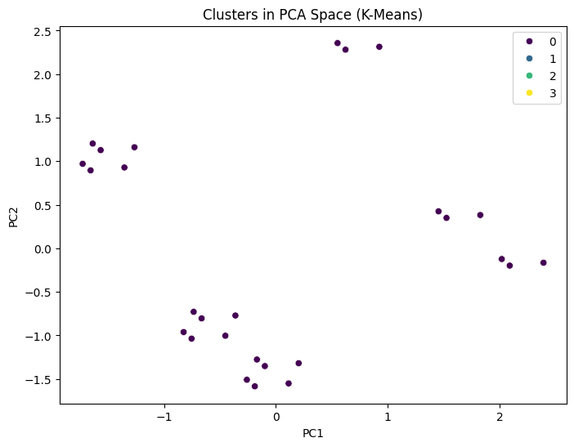
Clustering – K-Means
Tried to group similar cars without labels.
Clusters were loosely defined with silhouette score = 0.13 (low).
Acceptable for exploratory purposes but not strong for prediction.

Slide 16
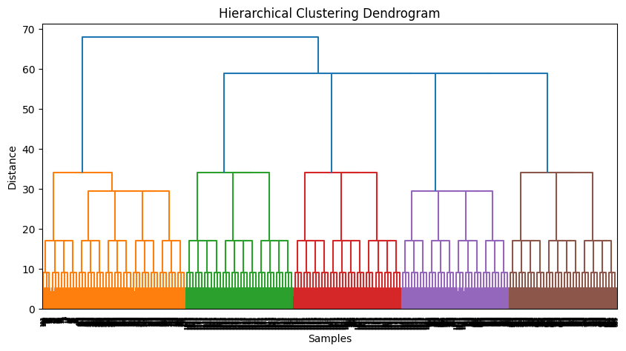
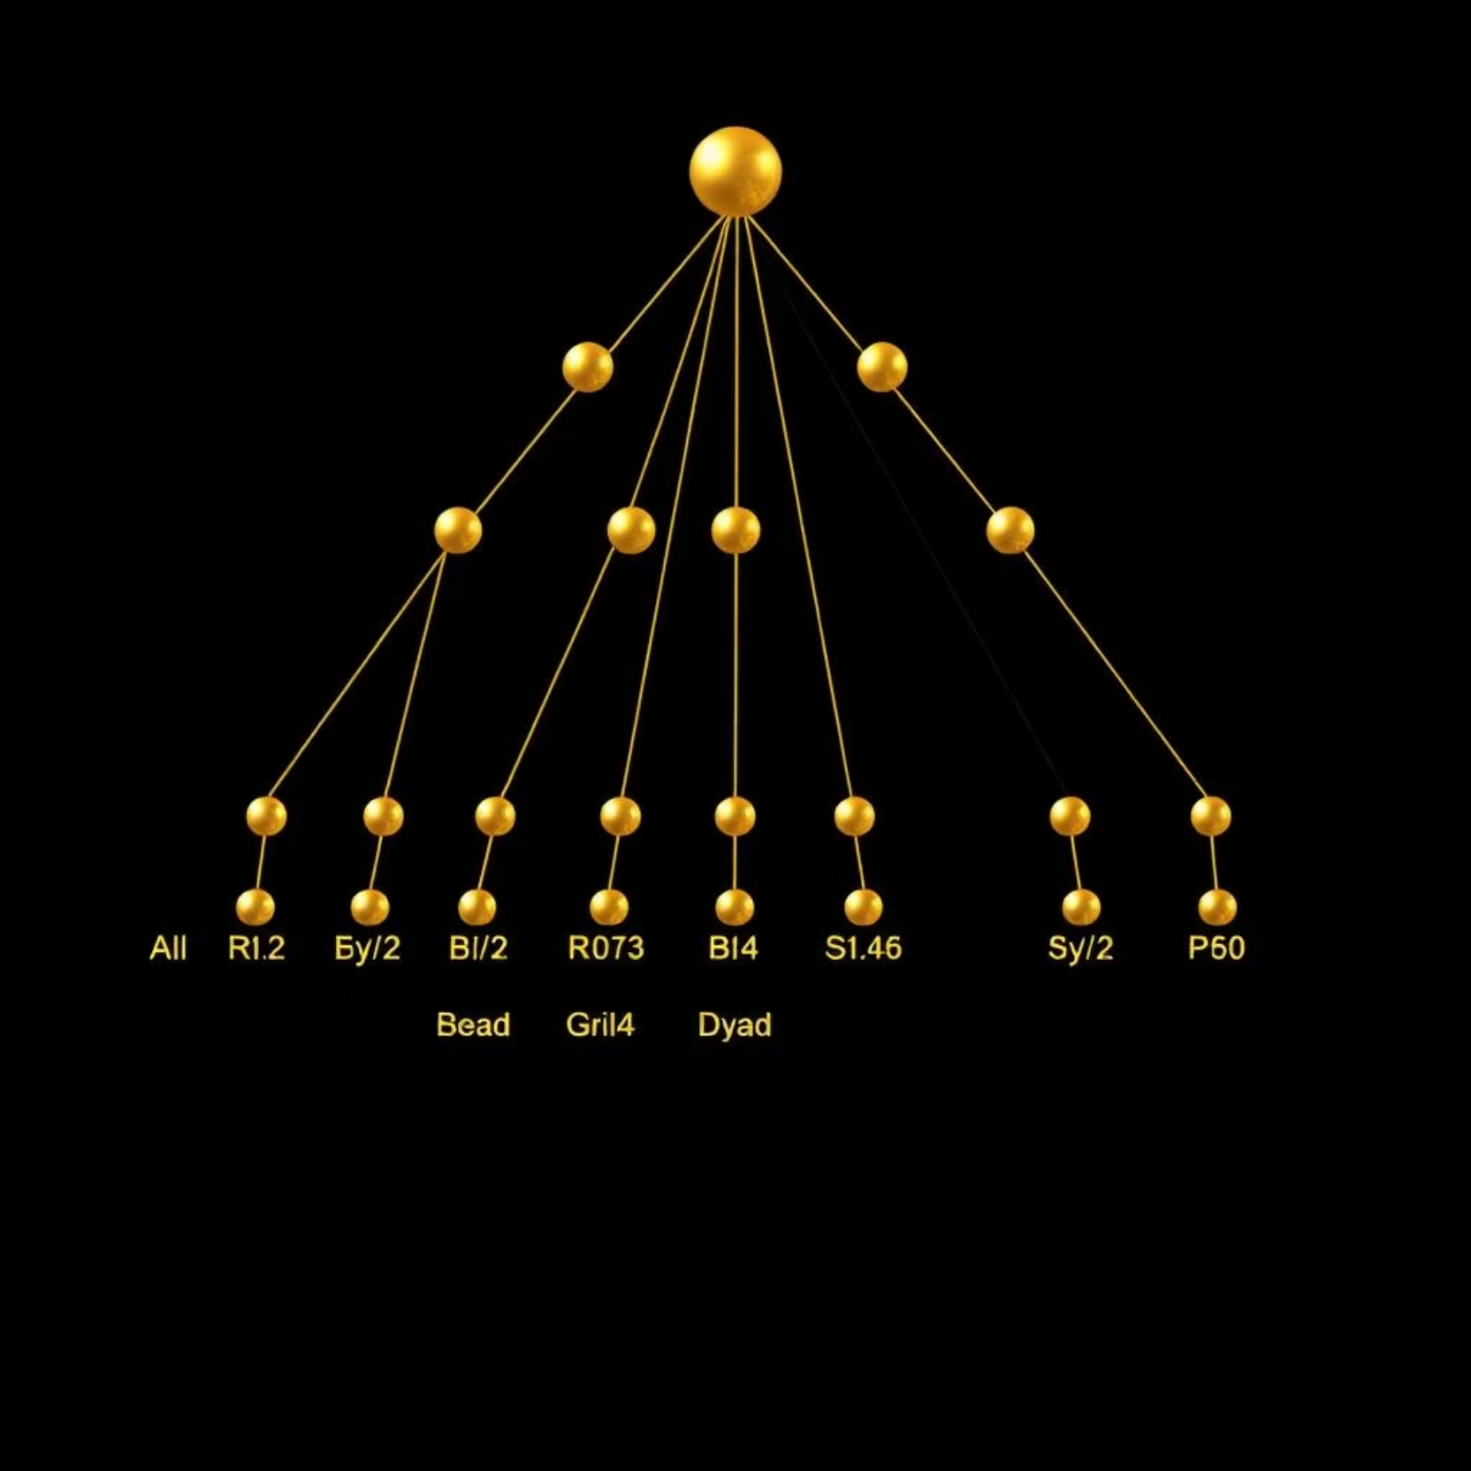
Clustering – Hierarchical
Built nested clusters (dendrogram).
Even lower silhouette score: 0.09, meaning less cohesion.
Difficult to separate car types clearly in 2D.

Slide 17
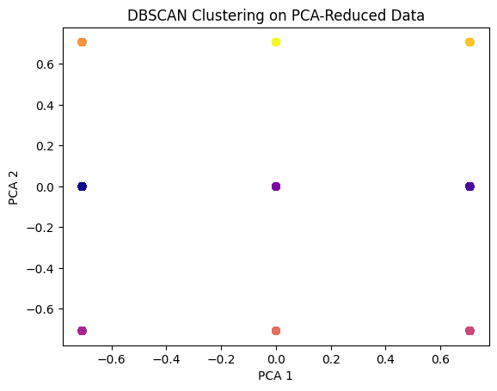
Clustering – DBSCAN
Poor Performance
Noise & Outliers
Unsuitable Data
Density-based method performed poorly.
Treated most cars as noise or outliers.
Suggests categorical, high-dimensional data is not suited for DBSCAN.

Slide 18
Discussion – Supervised Models
SVM & Random Forest
Decision Tree
Tree-Based Models
SVM and Random Forest handled one-hot data well.
Decision Tree also strong with categorical features.
Tree-based models are intuitive and rule-based—good fit for this dataset.

Slide 19



Discussion – Clustering & PCA
PCA Visualization
Clustering Limitations
Labels Necessary
PCA helped visualize but didn't reveal strong groupings.
Clustering couldn’t distinguish classes well.
Lack of clear structure means labels are necessary for effective learning.

Slide 20
Discussion – Data Issues
Imbalanced Classes
Model Bias
Potential Solutions
Imbalanced classes made it harder to predict rare cases.
Could bias models to predict “unacc” more often.
Solutions: oversampling (SMOTE), class weights, or ensemble methods.

Slide 21
Conclusion
Classification Effectiveness
Best Model
Classification is more effective than clustering here.
Best model: SVM, followed by Random Forest.
Clustering Value
Dataset Benefits
Unsupervised clustering added minimal value.
Dataset benefits from labeled guidance.

Slide 22
Future Work
Ensemble Models
Continuous Variables
Combine models into ensembles or hybrid approaches for better generalization.
SMOTE Implementation
Include continuous variables like fuel economy or engine size.
Try SMOTE to rebalance class distribution.

